Slide 1
DIABETES Prediction
Hillidatul Ilmi

Slide 2
TABLE OF CONTENTS
01
02
ABOUT diabetes
dataset information
03
04
Best Algorithm Model
Diabetes Disease Prediction
I can explain the topic of the section here regarding diabetes
I can explain the topic of the section here regarding the dataset used
I can explain the topic of the section here regarding the Model chosen algorithm
I can explain the topic of the section here regarding the predictive outcome of diabetes

Slide 3
01
About diabetes??

Slide 4
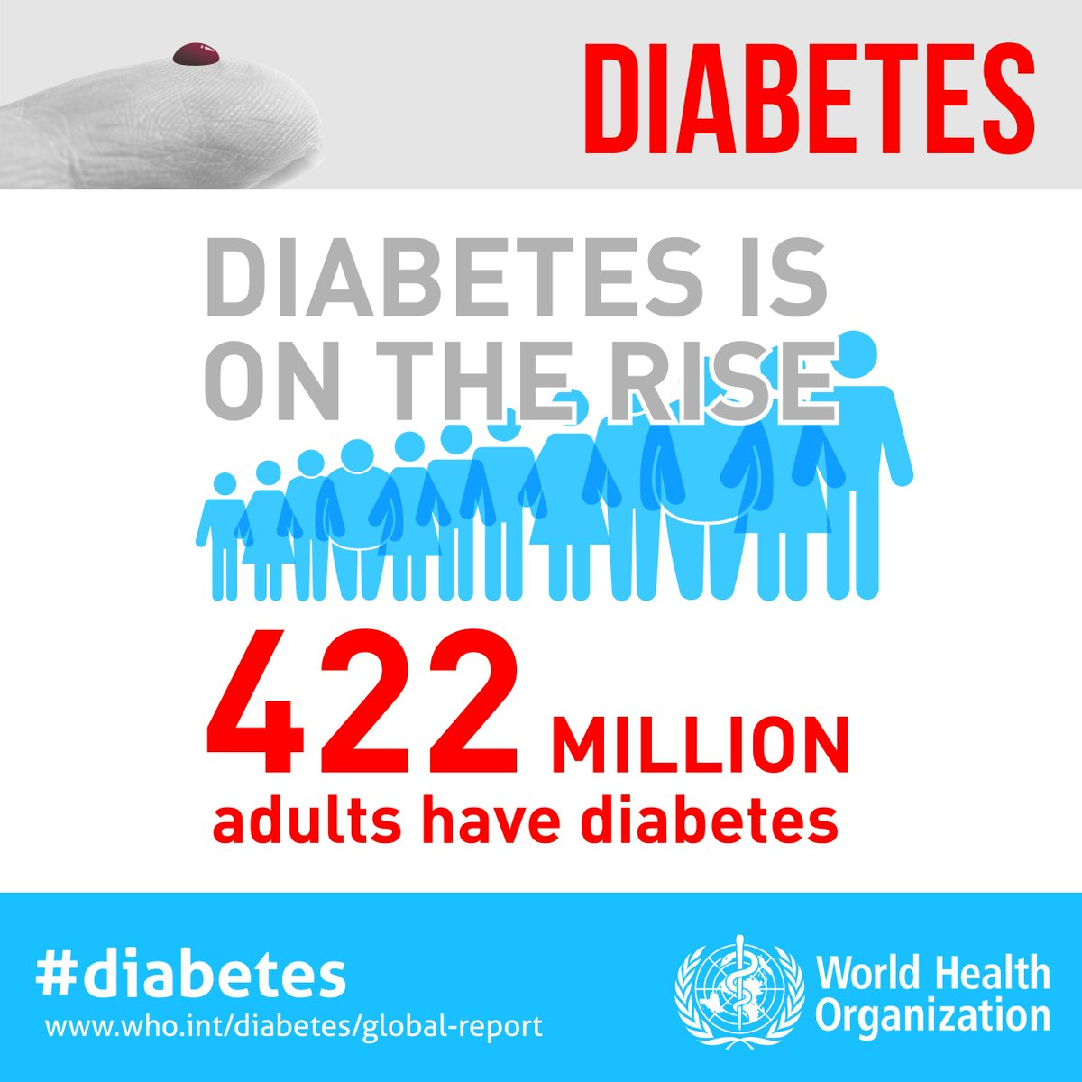
According to WHO, Diabetes is a chronic, metabolic disease characterized by elevated levels of blood glucose (or blood sugar), which leads over time to serious damage to the heart, blood vessels, eyes, kidneys and nerves.

Slide 5
02
DATASET
Information

Slide 6
Diabetes diagnostics for women aged at least 21 years of Indian Pima descent
Skin Thickness
Insulin
Triceps skin fold thickness (mm)
After 2-hour use of insulin serum (mu U/ml)
Blood Pressure
BMI
Diastolic blood pressure (mm/Hg)
Body mass index
(weight in kg/(height in m)^2)
Glucose
Plasma glucose tolerant Concentration (mg/dL):
Diabetes Pedigree Function
Diabetes due to genetics
Pregnancies
age
Number of times pregnant

Slide 7
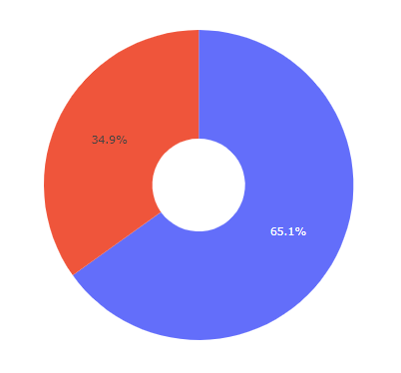

Exploratory Data Analysis
Pima Indian diabetes diagnostic target

Slide 8
03
Best algorithm model

Slide 9
algorithm model
Logistic Regression
Decision Tree
Support Vector Machine (SVM)

Slide 10



Cross Validation
Model Machine Learning
GridseachCV Logistic Regression

Slide 11
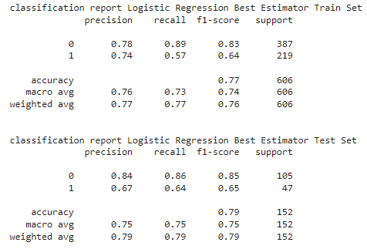

Classification Report Model
save the best models
> RECALL
logistic regression method for diagnosing diabetes of pima indians.
Where the patient does not have diabetes or is living healthy (Class 0)
the patient has diabetes (Class 1)
> Logistic Regression

Slide 12
Diabetes Disease Prediction
04

Slide 13
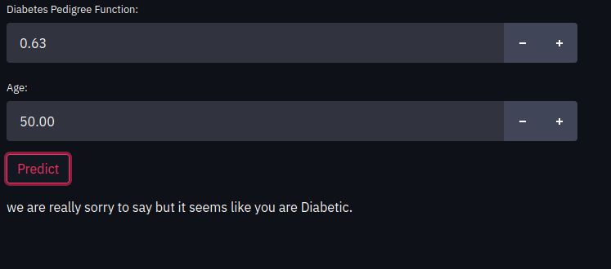
Diabetes diagnostics for women aged at least 21 years of Indian Pima descent diabetic

Slide 14
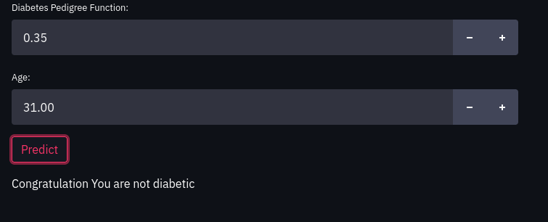
Diabetes diagnostics for women aged at least 21 years of Indian Pima descent Not diabetic

Slide 15
conclusion
This can be an evaluation for patients to pay more attention to healthy lifestyles, eating patterns, sleeping patterns, portions of strength at work, so that disturbances in carbohydrate, lipid, and protein metabolism as a result of insulin function insufficiency can be normal in general.
The best algorithm
model is the logistic regression, for deployment
The accuracy of the logistic regression model without the best estimator has a training value of 77.22% and a testing value of 78.94%

Slide 16
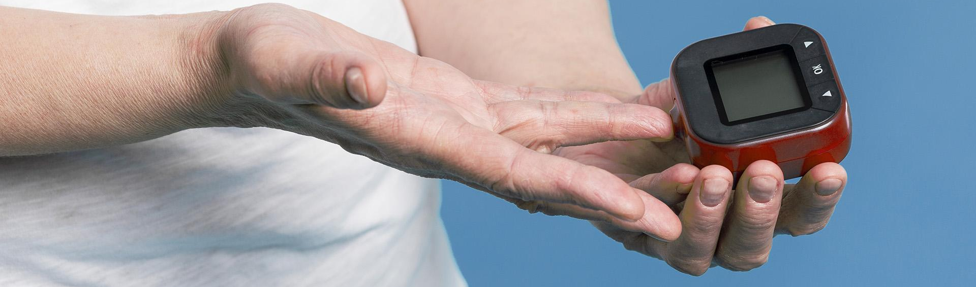
Thanks!

